Slide 1
CURD
C – Create
U- Update
R- Retrieve
D- delete

Slide 2
Deployment
Whenever we are creating, updating, retrieving and deleting any resource, it referred as deployment

Slide 3
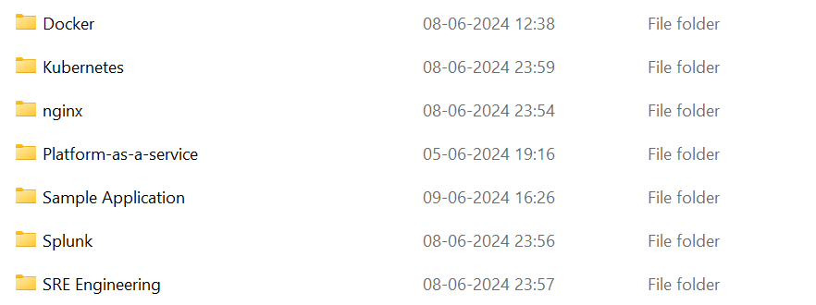
Management
Arranging resources in a proper way
Example: Lets say, I have study notes, then I would be managing them in a folder instead of keeping all of them in one place

Slide 4
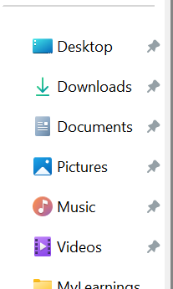

Slide 5
Resource group
Resource group is just a folder which keep your data organize.
Note: Resource group is mandatory in Azure, if you are not creating resource group then Azure will create for you by default.

Slide 6
Create resource groups
Sign in to the Azure portal.
Select Resource groups.
Select Create.
Enter the following values: ...
Select Review + Create.
Select Create. ...
Select Refresh from the top menu to refresh the resource group list, and then select the newly created resource group to open it.

Slide 7
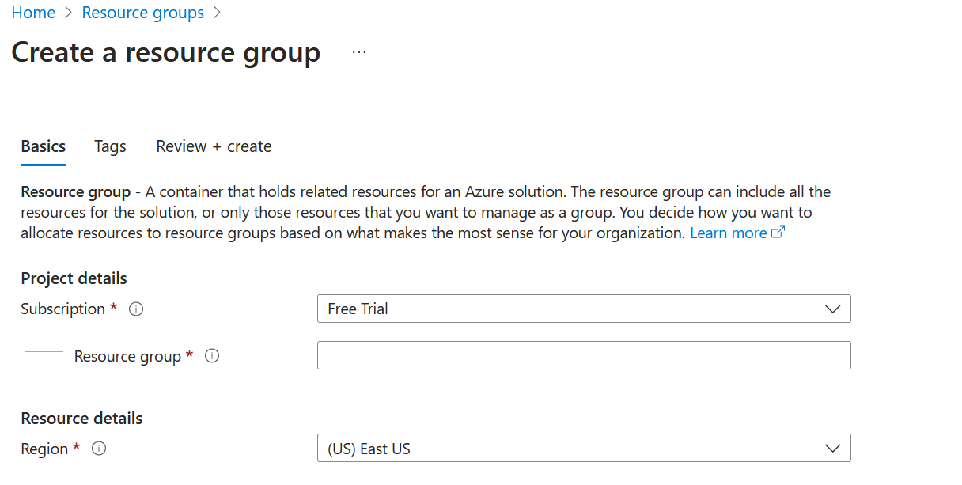

Slide 8
Example Naming Convention for Azure Resource Groups
Format: rg-<Environment>-<Department>-<Project>-<Location>-<UniqueID>
rg-dev-Learning-resourcegroup-euw1-001

Slide 9
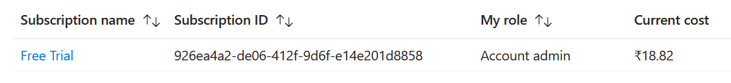
Authentication and authorization[Access control]
Authentication? Who are you
Authorization? What you can do
It means you are account admin, and you can create resource under free subscription.

Slide 10
REST API
REST API is a programming way to create, update, retrieve and delete the data.
A RESTful API is an architectural style for an application programming interface that uses HTTP requests to access and use data. That data can be used to GET , PUT , POST and DELETE data types, which refers to reading, updating, creating and deleting operations related to resources.

Slide 11
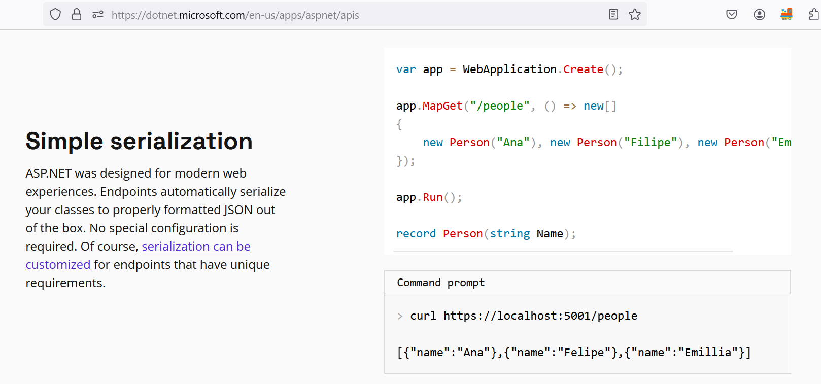
Link: https://dotnet.microsoft.com/en-us/apps/aspnet/apis

Slide 12
SDK
A software development kit (SDK) is a set of platform-specific building tools for developers.

Slide 13
lock
Same person shouldn’t be doing same activity.
Example: Let say me and my colleague trying to create same things in same time. So one would be pass one would be fail.
To avoid this confusion we have lock, so who would be doing first would be locking the resource.

Slide 14
metadata
It’s basically used to create filter mechanism
Mobile > Redmi > Redmi13C
Category: Mobile
Brand: Redmi
Model: Redmi13C

Slide 15
tag
Meta data given to resource
Environment: Dev
Owner: Umesh
Batch: Batch1
https://learn.microsoft.com/en-us/azure/azure-resource-manager/management/tag-resources

Slide 16
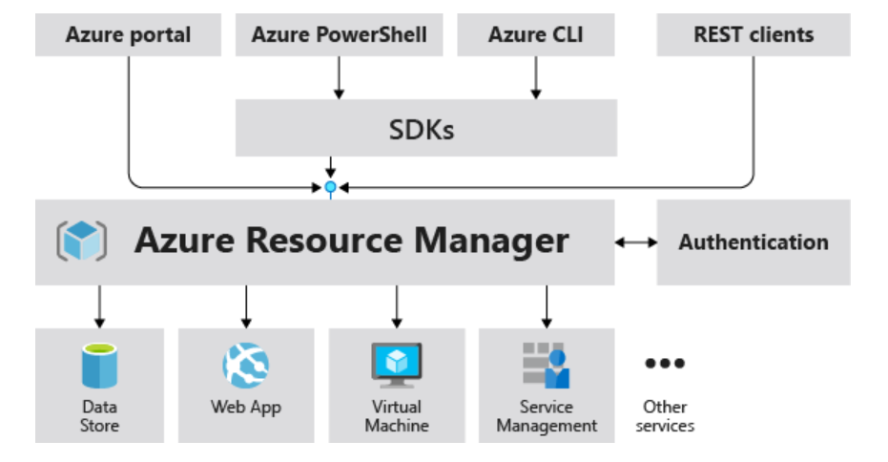
ARM diagram

Slide 17
What is ARM
Azure Resource Manager is the deployment and management service for Azure. It provides a management layer that enables you to create, update, and delete resources in your Azure account. You use management features, like access control, locks, and tags, to secure and organize your resources after deployment.
Link: https://learn.microsoft.com/en-us/azure/azure-resource-manager/management/overview

